Slide 1

Inventory Segmentation & Shipment Prediction
Ng Soo Kuan

Slide 2
Agenda
Business Problem & Understanding
Proposed Analytic Solutions
Data Understanding
Inventory Segmentation (ABC-XYZ)
Shipment Prediction with Machine Learning
Conclusion
Limitations & Recommendation

Slide 3
Business Problems and Understanding
Recent increase inventory holding and shipment cost impact the profit margin in company.
The shipment of all products are ship as usual. Extra cost and resources used on those products that generate lower revenue or unstable demand which contribute to waste.
Unforeseen shipment delay may impacts the revenue and customers’ satisfaction.

Slide 4
Proposed Analytic Solutions
Gather data
Inventory Segmentation (ABC-XYZ)
Strategize Inventory management based on different segments
Develop shipment prediction to minimize the risk of shipment delay on high priority segment

Slide 5
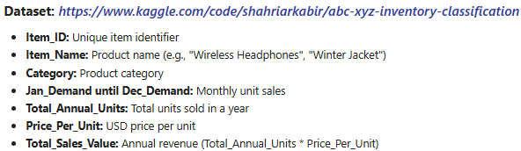
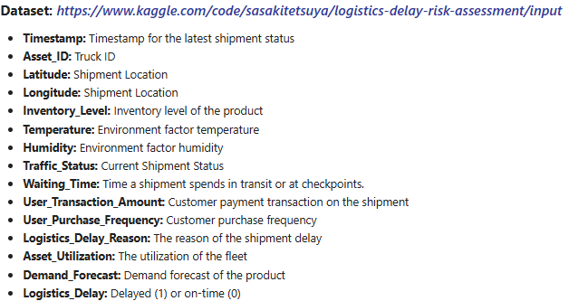
Data understanding
2 different datasets will be use for inventory segmentation and shipment prediction
Inventory Segmentation Dataset
Shipment Prediction Dataset
vzv

Slide 6

Inventory Segmentation (ABC-XYZ)
ABC-XYZ inventory classification is a method use by supply chain inventory control
Inventory ABC Segmentation
ABC inventory classification is based on annual consumption value: Total Annual Sales Unit * Price per Unit).
Inventory XYZ Segmentation
XYZ inventory classification is based on predictable or stable demand. It can calculate by Coefficient of Variation (CV) : Standard Deviation (Demand)/ Mean (Demand)

Slide 7
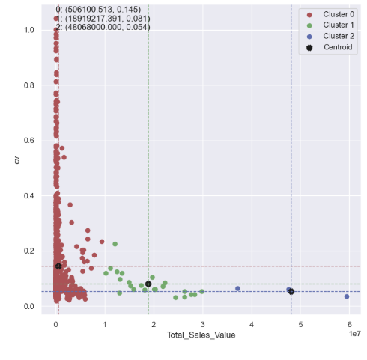
Inventory Segmentation (ABC-XYZ)
Kmeans Clustering (k=3) by using CV (XYZ) and Total Sales Value (ABC)
Cluster | Inventory Classification
Cluster 0 (Red) | Low total sales value (C-class), mix of low (X-class), medium (Y-class) and high (Z-class) cv value.
Cluster 1 (Green) | Medium total sales value (B-class), medium cv value (Y-class).
Cluster 2 (Blue) | High total sales value (A-class), low cv value (X-class).

Slide 8
Inventory Segmentation (ABC-XYZ)
Different strategies implemented based on the each inventory segment.
Cluster | Inventory Management Strategy
Cluster 0 (Red) | CX & CZ Class - Bulk ordering to reduce cost, less frequent replenishment and basic forecasting. For high cv value, can ignore, discontinue or keep minimal stock.
Cluster 1 (Green) | BY Class - Keep moderate stock, forecast using moving average, plan with medium flexibility
Cluster 2 (Blue) | AX Class - Tight control inventory, regular review and accurate forecasting, Just In Time (JIT) replenishment

Slide 9
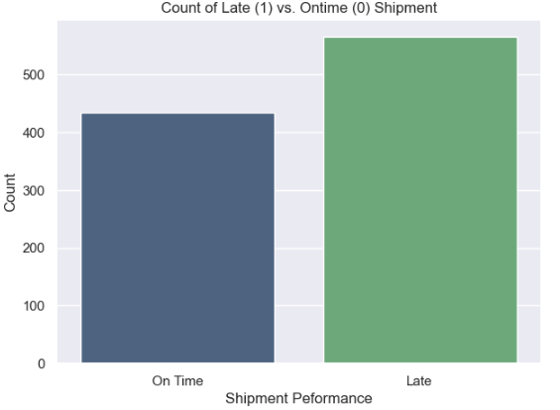
Shipment prediction with machine learning
After clustering, we need to prioritize cluster 2 (Blue) which belongs to AX class.
Since Just In Time (JIT) replenishment is needed, we need to build a prediction model to predict the shipment risk.
Expedite the shipment if there is any potential shipment delay on this cluster.
Another dataset is used to develop the machine learning model for shipment risk prediction
Total number of On Time and Late Shipment in shipment records

Slide 10
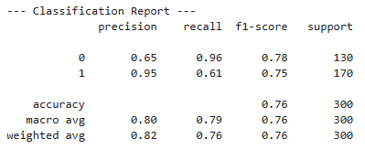
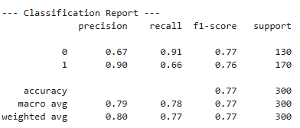
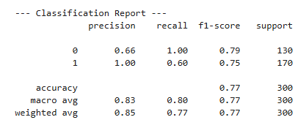
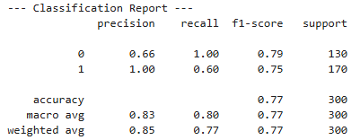
Shipment prediction with machine learning
Comparison of 3 models: Logistic Regression, Support Vector Machine and Naïve Bayes. Prediction on delay = 1 is very important, we focus on the recall metrics (of all actual delayed, how many are corrected predicted)
Logistic Regression
Support Vector Machine
Naïve Bayes
Without tuning
With tuning

Slide 11
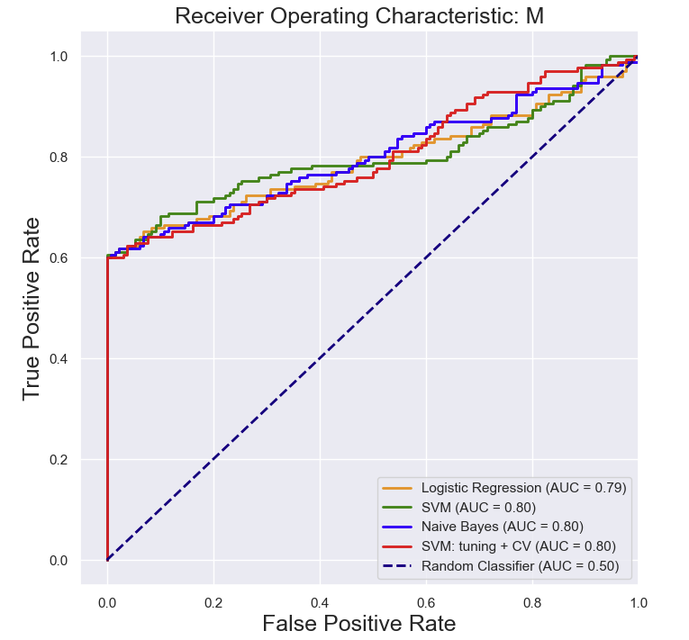
Shipment prediction with machine learning
Model Evaluation by using AUC and ROC curve
Logistic Regression selected to predict shipment delay. (Out of all actual shipment delayed, model can predict 66% of it)
Model | Summary Performance
Logistic Regression | Recall: 0.66
SVM | Recall: 0.61
Naïve Bayes | Recall: 0.60
SVM with tuning & cross validation | Recall: 0.60

Slide 12
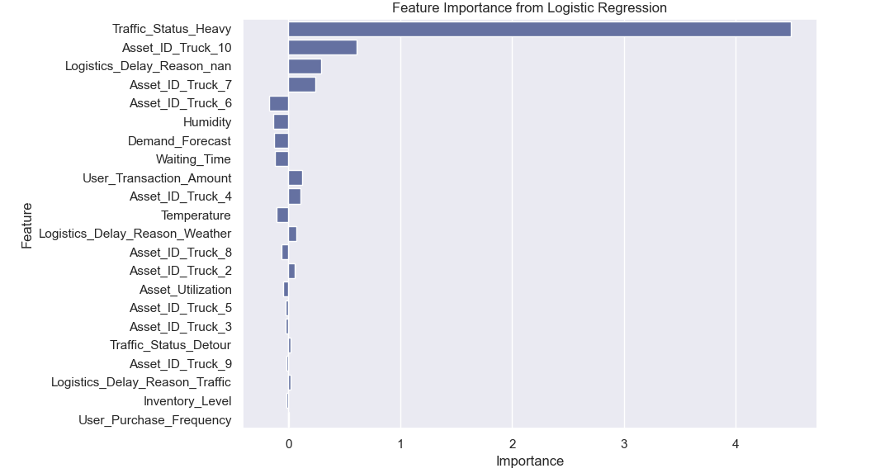
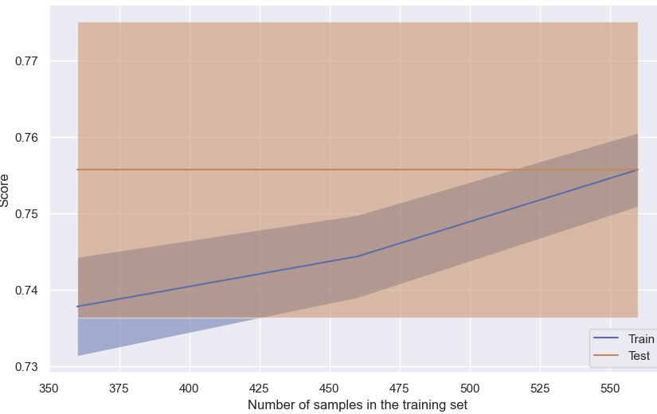
Shipment prediction with machine learning
Feature Importance: Understand which features contribute to prediction modelling significantly
Learning Curve: Increase the training set will increase the score of training set only.

Slide 13
Conclusion
Products segmentation can be done by using the combination ABC-XYZ and Kmeans Clustering methods.
Different inventory management strategies can be implemented based on different segments.
Prioritize product with AX class (high total sales, stable demand) which require just in time replenishment.
Supply shipment on products with AX class need to prioritize.
Shipment risk (Late) can be predicted by using Logistic Regression model (Recall: 66%). Extra resources can be allocated on shipment that have high probability of delay.

Slide 14
limitations And Recommendations
Limitations | Recommendations
Currently project limit to certain Machine learning models. | Other machine learning models like random forest, boosting, bagging, stacking or neural network can be tried to improve the model performance.
The demand forecast use for inventory (XYZ) classification may not accurate. Wrong strategy implemented on inaccurate clustering. | Need another analytic initiative to check the forecast accuracy (forecast vs actual sales). Advance forecasting method may potential implement to predict the future demand.
Heavy Traffic is the major contributor to the shipment delay. It is very difficult to prevent shipment delay once shipment caught in heavy traffic. | Extra resources need to allocate on shipment/custom clearance once the shipment arrived. Expedite the transport operation.

Slide 15
Reference
https://www.kaggle.com/code/shahriarkabir/abc-xyz-inventory-classification
https://www.kaggle.com/code/sasakitetsuya/logistics-delay-risk-assessment/input

